Slide 1
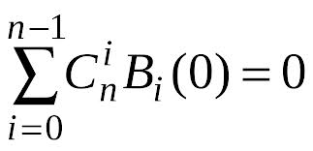
THE HISTORY OF MATHEMATICAL SYMBOLS

Slide 2
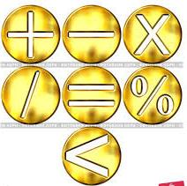
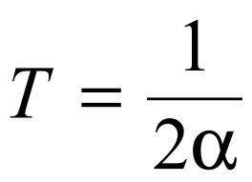
Mathematical notation - a symbols used for the compact notation of mathematical equations and formulas. In addition to the numbers and letters of different alphabets, mathematical language uses a set of special characters that were invented in the last few centuries.

Slide 3
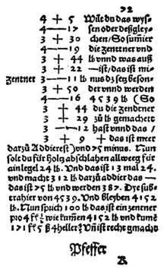
First the plus (+) and minus (-) were used in the book "Arithmetic", written by Johannes Widmann in 1489.
12+5.6
45-17
12p5.6
45m17

Slide 4
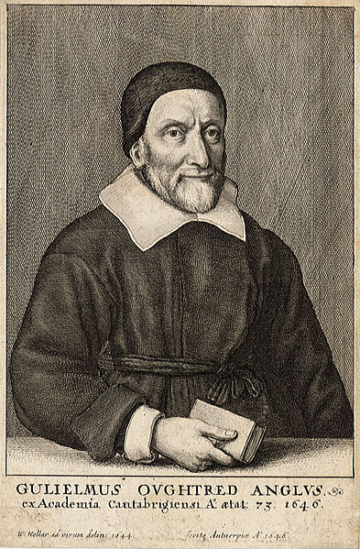
Multiplication sign introduced in 1631 by William Otrad (England) in the form of oblique cross.
5×7
5M7
5 7
5*7
5 ⋅ 7

Slide 5
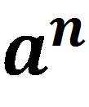
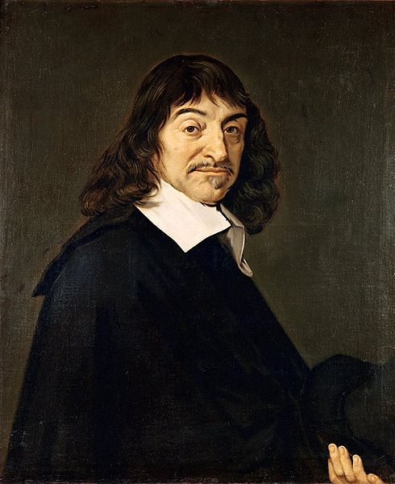
The current record of the exponent introduced by Descartes in his "Geometry" (1637)

Slide 6
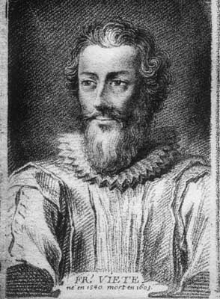
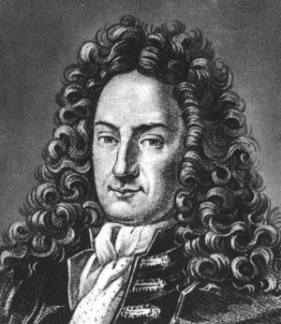
( )
Round brackets appeared in Tartaglia (1556)
{ }
Curly brackets introduced by Wyeth (1593)
In common usage brackets introduced Leibniz and Euler.
Wyeth
Leibniz

Slide 7
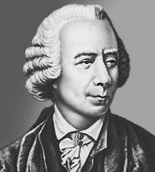
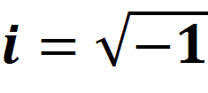
Letter i like the code of the imaginary unit proposed Euler (1777), who took this first letter of the word imaginarius.

Slide 8
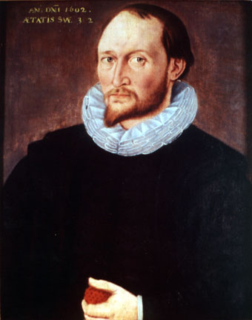
Signs compare Thomas Harriot introduced in his book, published posthumously in 1631.
< >
Until he wrote the words: more, less

Slide 9
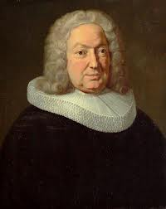
Abbreviations for sine and cosine William Otrad introduced in the mid XVII century.
Abbreviations tangent and cotangent: introduced by Johann Bernoulli in XVIII century
Sin
Cos
tg
Ctg
Johann Bernoulli

Slide 10
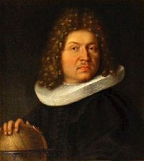
Term "integral " was coined the Jacob Bernoulli (1690).
Designation integral Leibniz made ​​from the first letter of the word “Summa”
∫

Slide 11
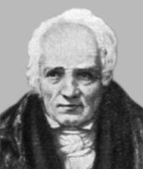
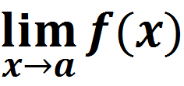
Symbol limit has appeared at Simon L'Huilier

Slide 12
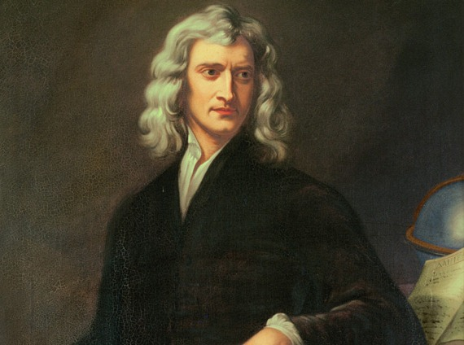
Indexation for numbering of variables in the current form introduced Newton (1717).
x_{n}

Slide 13
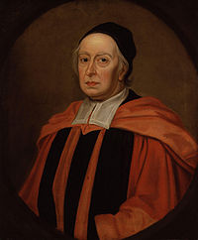
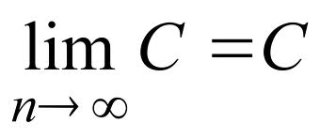
The factorial invented Christian Crump (1808)
Infinity symbol invented by Wallace(1655)
n!
∞
Wallace

Slide 14
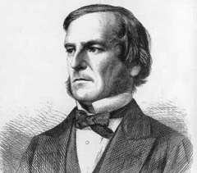
Symbols logical operations suggested George Boole (1854).
∧,&
conjunction
∨,|
disjunction

Slide 15
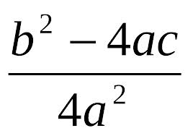
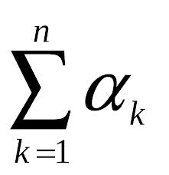
Mathematical expressions can be read by anyone regardless of their spoken language.
Mathematical signs allow you to record in a compact form of a proposal, the expression of which in ordinary language would be cumbersome.

