Slide 1
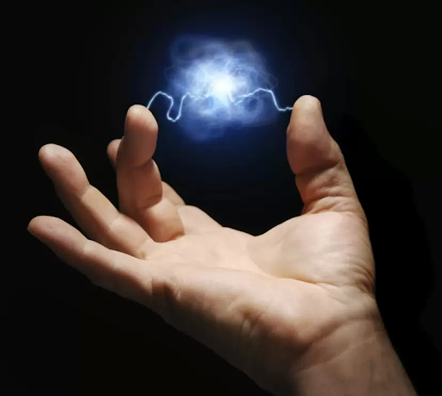
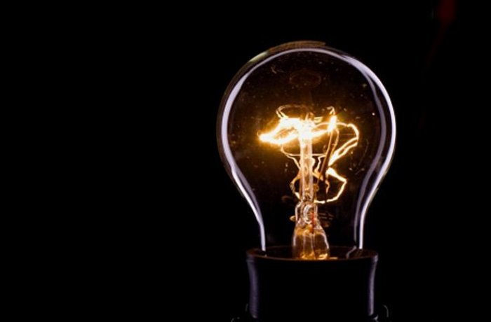
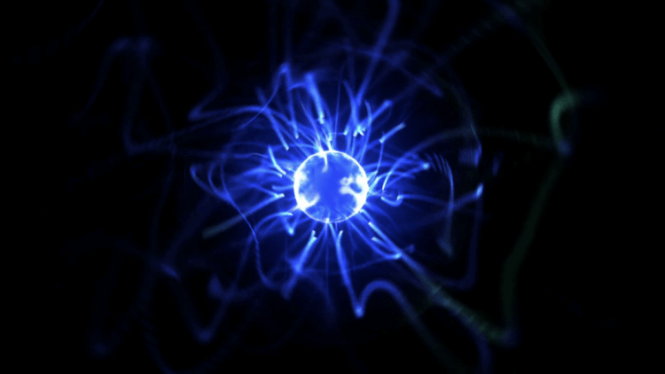
Electricity.
Electricity is something that we use every day, and sometimes don’t realize how much we use it, or depend on it.

Slide 2
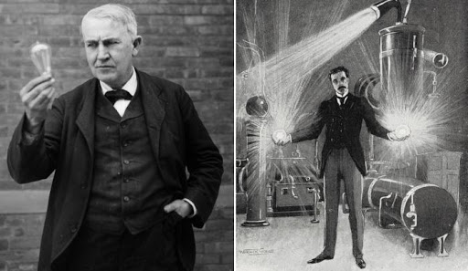
Thomas Edison Nicholas Tesla

Slide 3
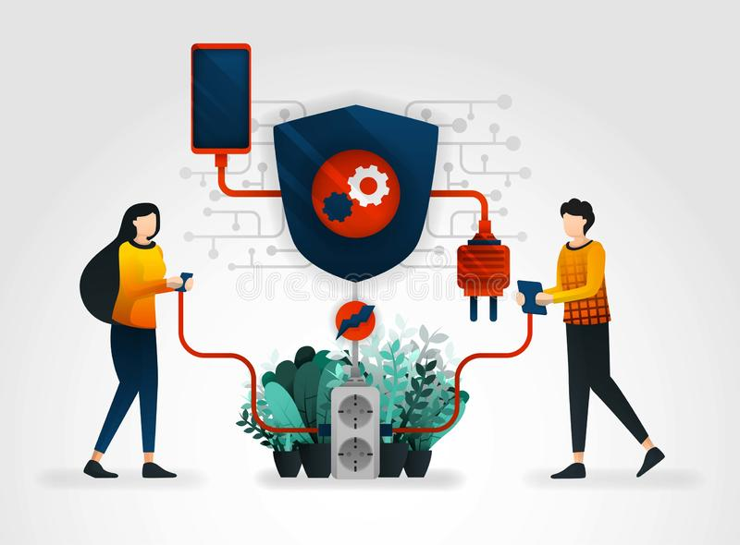
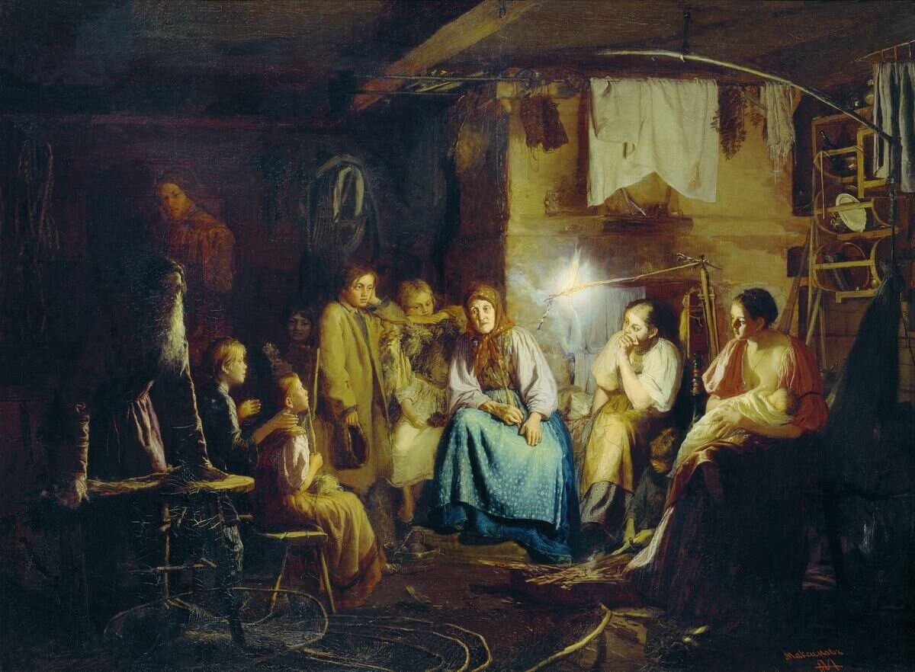
It is difficult to imagine life without electricity now.

Slide 4
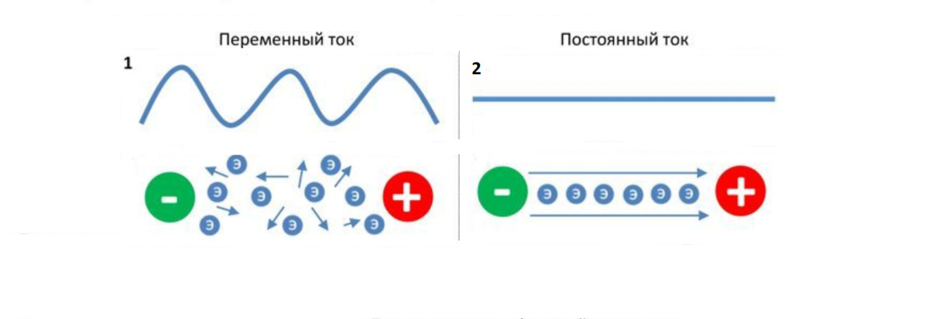
Electric current.
A current that always flows in one direction is called a direct current (DC). A battery for example, produces a direct current. A current that flows back and forth is called an alternating current (AC).

Slide 5
In our modern world electricity is used for industry and agriculture, communication and transportation, and for everyday use.

Slide 6
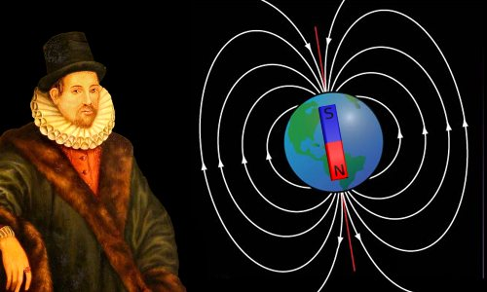
William Gilbert
The development of electricity dates back to the late 17th century and the great discovery of the power source of energy was made by William Gilbert. A great number of further important discoveries were made over the next two centuries – among them are a light bulb and electromagnetic induction principle.

Slide 7
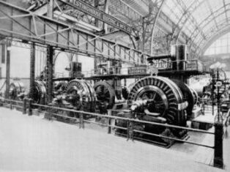
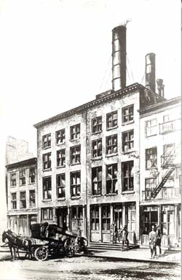
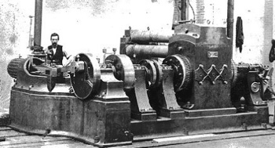
First steam-powered station.
The start of the electrical industry began in 1881 when the first power station in the world was constructed at Godalming in England. Then in 1882 the great inventor Thomas Edison and his Edison Electric Light Company started their first steam-powered station in New York.

Slide 8
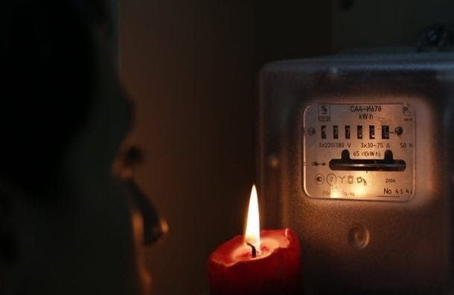
But what is the electricity?
From the scientific point of view, the electricity is a particular set of physical phenomena which is characterized by the presence and the distinctive flow of electric charge.

Slide 9
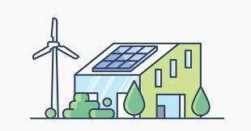
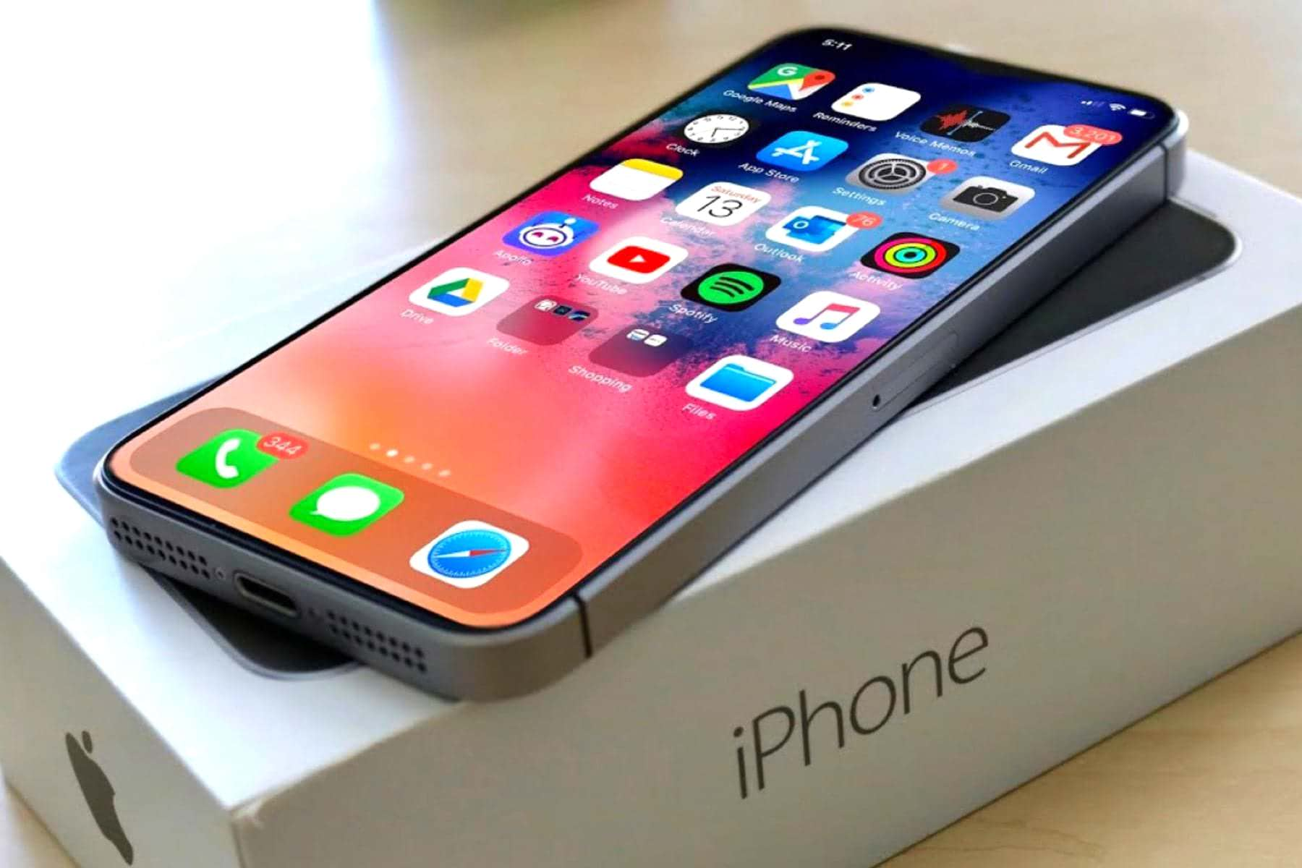
We use electrical power for heating, cooling and lighting our houses, for cooking food, and for numerous devices and gadgets such TV-sets, computers and smartphones.

Slide 10
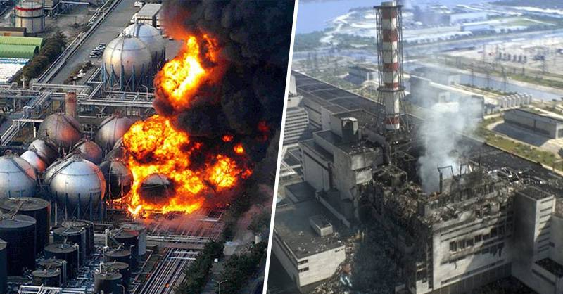
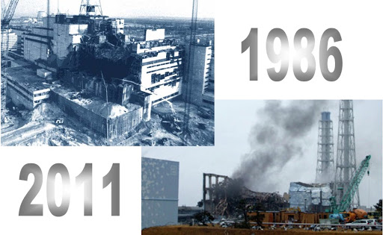
One of the most efficient but dangerous means of electricity generation is a nuclear power station.

Slide 11
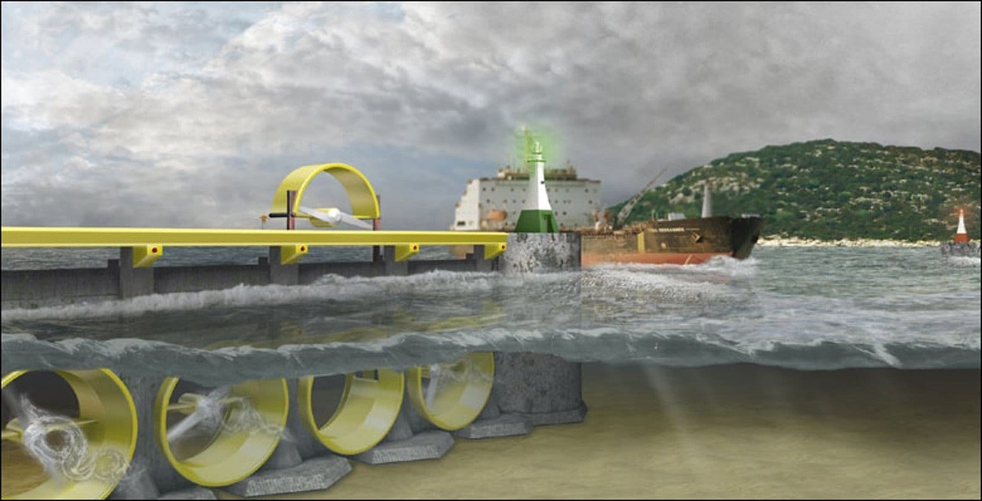
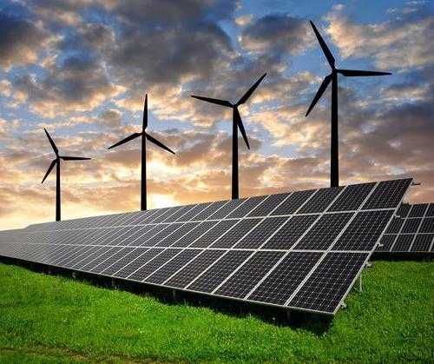
The process of nature friendly electricity generation has been developing greatly these days. Wind power, solar power and the power of the ocean are used to generate safe and cheap electricity that will be able to bring our life to the next level of evolution.

Slide 12
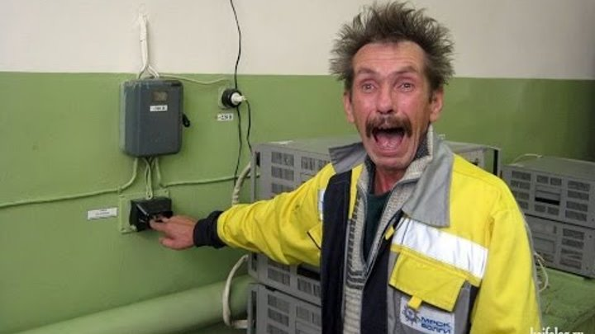
Thanks for attention.

