Slide 1
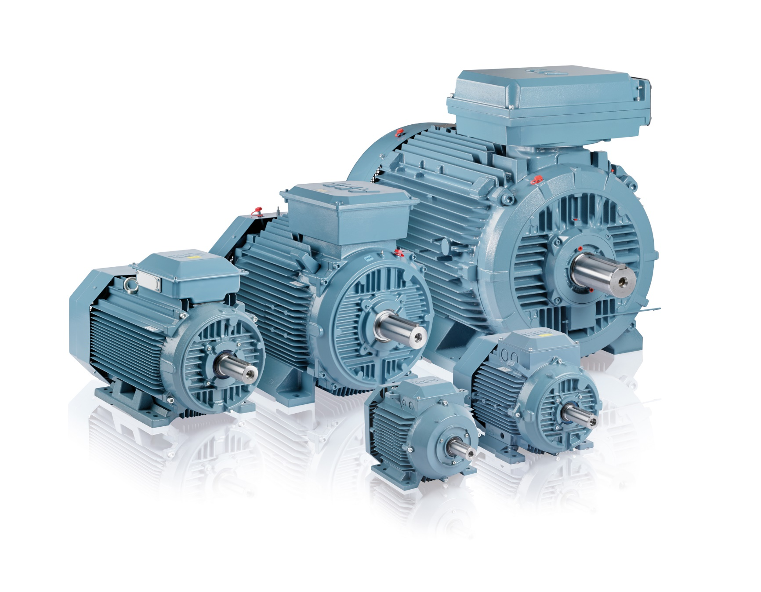
AC Motors and types

Slide 2
Definition
AC motor is an electric motor driven by an alternating current (AC)
The AC motor commonly consists of two basic parts, an outside stationary stator having coils supplied to produce a rotating magnetic field, and an inside rotor attached to the shaft producing a second rotating magnetic field
The rotor magnetic field may be produced by permanent magnets, reluctance or AC electrical windings

Slide 3
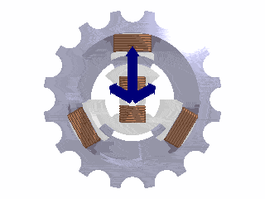
Operating Principles
When an AC motor is in rotation (motion), the magnetic fields of the rotor and stator rotate (move) with little or no slippage
The magnetic forces (repulsive and attractive) between the rotor and stator poles create average torque, capable of driving a load at rated speed
The speed of the stator and rotor rotating magnetic field relative to the speed of the mechanical shaft
Must maintain synchronism for average torque production by satisfying the synchronous speed relation

Slide 4
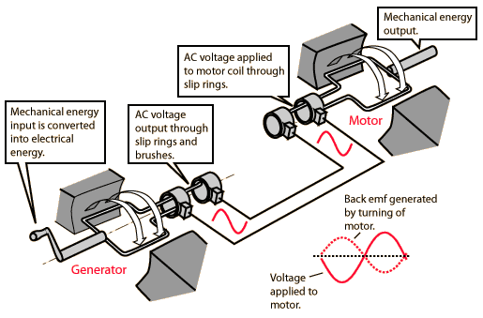
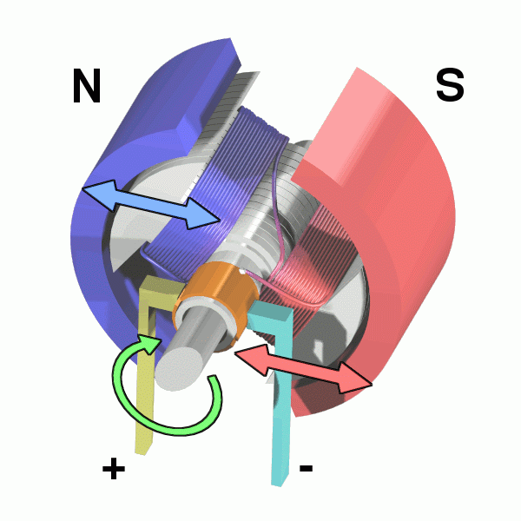
Operating Principles

Slide 5
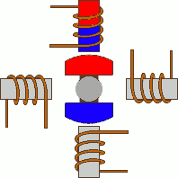
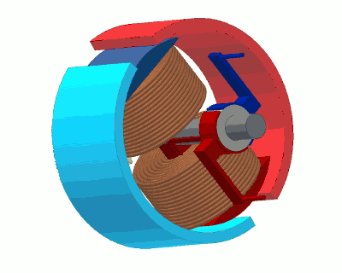
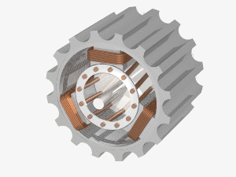
Operating Principles
The stator of the motor consists of overlapping winding offset by an electrical angle of 120°
When the primary winding or the stator is connected to a 3 phase AC source,
It establishes a rotating magnetic field which rotates at the synchronous speed

Slide 6
Components of AC motor
Enclosure
Stator
Rotor
Bearings
Conduit Box
Eye Bolt

Slide 7
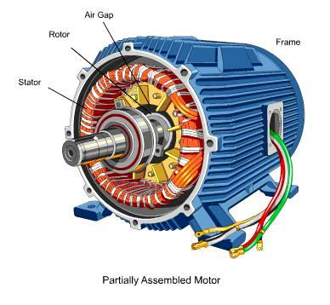
Enclosure (frame)
The enclosure consists of a frame (or yoke) and two end brackets (or bearing housings)
A motor's enclosure not only holds the motor's components together, it also protects the internal components from wetness, corrosion and damaging. The degree of protection depends on the enclosure type.
In addition, the type of enclosure affects the motor's cooling

Slide 8
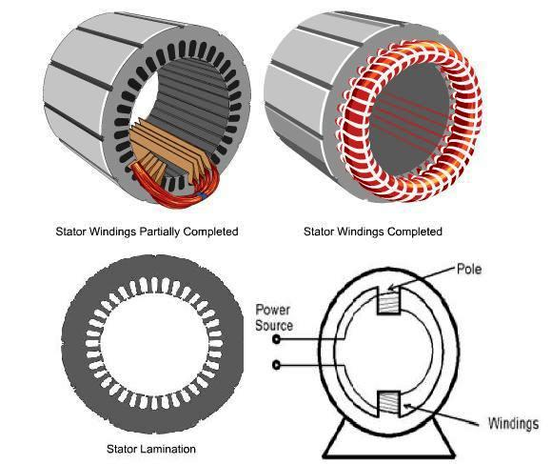
Stator
The stator is the stationary part of the motor's electromagnetic circuit. The stator is electrical circuit that performs as electromagnet.
The stator core is made up of many thin metal sheets, called laminations.
Laminations are used to reduce energy losses that would result if a solid core were used
Stator laminations are stacked together forming a hollow cylinder
Coils of insulated wire are inserted into slots of the stator core
The stator windings are connected directly to the power source
Each grouping of coils, together with the steel core it surrounds
Becomes an electromagnet when current is applied

Slide 9
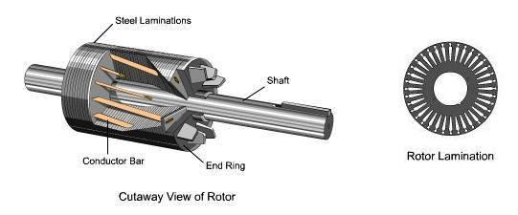
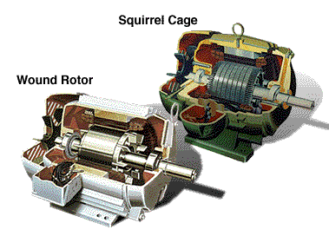
Rotor
The rotor is the rotating part of the motor's electromagnetic circuit
Magnetic field from the stator induces an opposing magnetic field onto the rotor causing the rotor to “push” away from the stator field
There are a lot of rotor types like Squirrel cage rotor and wound rotor

Slide 10
Bearings
Bearings are mounted on the shaft, support the rotor and allows it to turn
The choice of bearing arrangement is based on the following qualities:
Load carrying capacity in the axial and radial direction
Over speed and duration
Rotating speed
Bearing life
Other factors must also be taken into consideration, such as operating temperature, dirty and dusty environmental conditions, and vibration and shocks affecting bearings in running and resting conditions

Slide 11
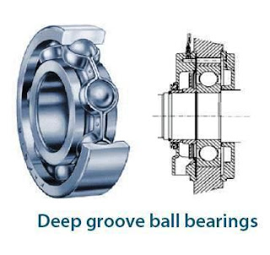
Deep groove ball bearings
Deep groove ball bearings are the most common type of bearing
Can handle both radial and thrust loads
Due to their low-frictional torque, they are suitable for high speeds

Slide 12
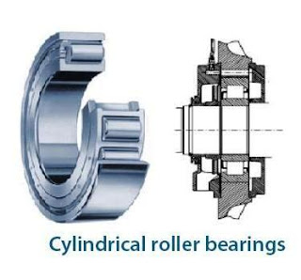
Cylindrical roller bearings
These roller bearings are used in applications where they must hold heavy radial loads
In the roller bearing, the roller is a cylinder, so the contact between the inner and outer race
This spreads the load out over a larger area, allowing the bearing to handle much greater radial loads than a ball bearing

Slide 13
Spherical roller thrust bearing
In Spherical Roller thrust bearings, the load is transmitted from one raceway to the other at an angle to the bearing axis
They are suitable for the accommodation of high axial loads in addition to simultaneously acting small radial loads
Spherical roller thrust bearings are also self-aligning

Slide 14
Conduit Box
Point of connection of electrical power to the motor’s stator windings

Slide 15
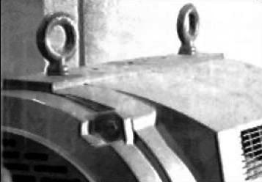
Eye Bolt
Used to lift heavy motors with a hoist or crane to prevent motor damage

Slide 16
Types of AC motor INDUCTION MOTOR
An induction or asynchronous motor is an AC electric motor in which the electric current in the rotor needed to produce torque is obtained by electromagnetic induction from the magnetic field of the stator winding
An induction motor therefore does not require mechanical commutation, separate-excitation or self-excitation for all or part of the energy transferred from stator to rotor, as in universal, DC and large synchronous motors.
An induction motor's rotor can be either wound type or squirrel-cage type

Slide 17
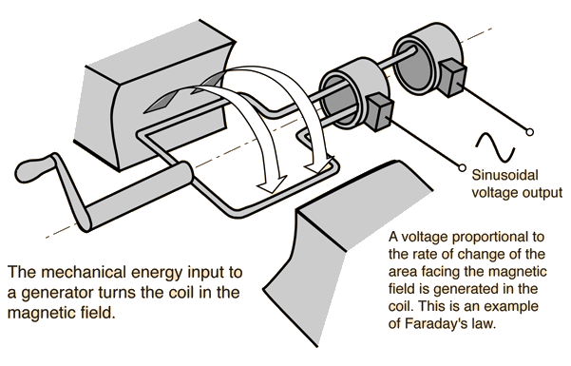
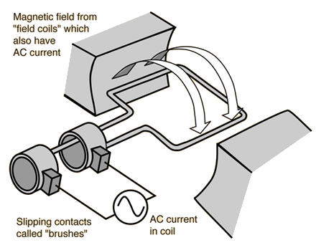
INDUCTION MOTOR
Induction Motors are the most commonly used motors in many applications. These are also called as Asynchronous Motors, because an induction motor always runs at a speed lower than synchronous speed
the AC power supplied to the motor's stator creates a magnetic field that rotates in time with the AC oscillations
Whereas a synchronous motor's rotor turns at the same rate as the stator field, an induction motor's rotor rotates at a slower speed than the stator field
The induction motor stator's magnetic field is therefore changing or rotating relative to the rotor.

Slide 18
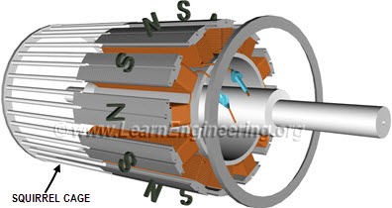
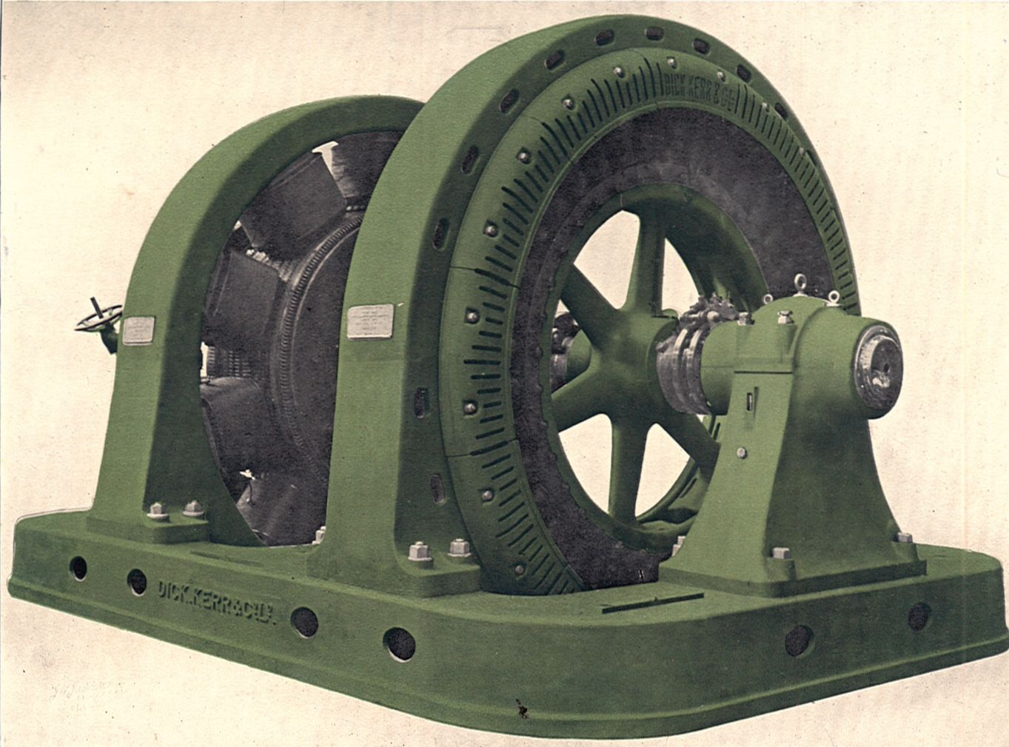
SYNCHRONOUS MOTOR
A synchronous electric motor is an AC motor in which, at steady state, the rotation of the shaft is synchronized with the frequency of the supply current
The rotation period is exactly equal to an integral number of AC cycles
Synchronous motors contain multiphase AC electromagnets on the stator of the motor that create a magnetic field which rotates in time with the oscillations of the line current
The rotor with permanent magnets or electromagnets turns in step with the stator field at the same rate and as a result, provides the second synchronized rotating magnet field of any AC motor
A synchronous motor is only considered doubly fed if is supplied with independently excited multiphase AC electromagnets on both the rotor and stator

